Slide 1
Welcome to Online Examination system

Slide 2
Supervised By
Nazrul Islam
Assistant Professor
Dept. of Information & Communication Technology, MBSTU.
Developed By
Mahbuba Zaman Mitu IT-16044
Nadira Islam IT-17051
Md. Al Amin IT – 16045
Md. Hellol Biswas IT-15025
Nazmul Hasan Nayeem IT-17052

Slide 3
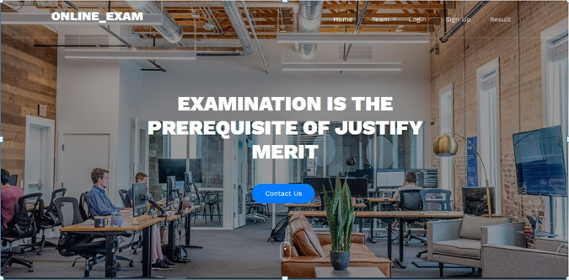
When a user browse into our site. He/she will see the following page like this:

Slide 4
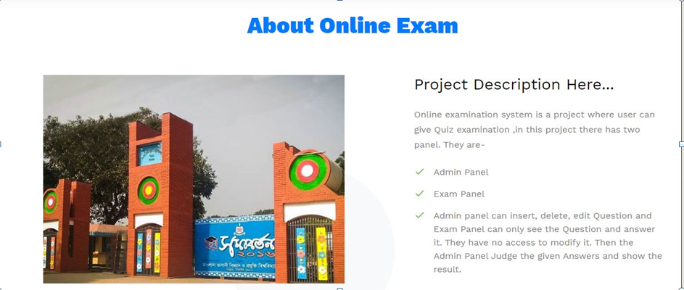
When a user click on About on the navigation bar. He/she will learn about our project :

Slide 5
Content with Presentation
Introduction
Literature Review
Methodology
Implementation
Analysis and Design
Project View
Discussion And Conclusion
1

Slide 6
Introduction
Proposed project:
The student’s online exam system application will help in taking the student’s quiz examination through internet.. All details about the student’s result will be available on a click both user and admin via internet. As the system is online the information is globally present to everyone. Every client will be given with a different username and password so it can be maintained properly.
Motivation:
The advantages of an online quiz examination system include eliminating redundant and expensive processes, bolstering the bottom line of an educational institution administering the system.
Objectives:
Examiners get tired checking huge number of answer sheets, hence the system reduces their workload by automating the manual checking process accurately.
The system calculates the score and provides results instantly..
Thus the system excludes human efforts and saves time and resources.

Slide 7
This is a slide title
Literature Review
A Literature review is essential as it summarizes all the relevant topics. A Literature review should be focused on.
1.Software project Analysis:
System Analysis is a described study of the various operations performed by a system and their relationships within and outside of the system.
2.Software processes models: The activities of software development are represented by the software process model. Each process model applies to particular perspectives.
Waterfall model
Prototyping model
Reuse oriented model
3.System development life cycles:
Analysis
Design
Implementation
Maintenance

Slide 8

Technology used
Frontend Code:
Html, css, javascript, jsp, Bootstrap theme.
Backend Code:
Java, servlet,jsp,database.
1.Html:Hypertext Markup Language (HTML) is the standard markup language for creating web pages and web applications
There are many tags in HTML but some of them are frequently used. Some of them are include in .
Example:
<p> </p>=To write paragraph
<img>= Insert image on Html page

Slide 9
CSS
CSS can be included in four ways. Among them inline CSS and External CSS are most commonly used.
Inline CSS: Inline CSS are applied inside the html tags and that element will only get CSS effects. It is specified by HTML style attributes.
External CSS: It is an external text file with CSS code and .css file extension. <link> tag is used to include external css file in the head section of any html document. External CSS ensure clean code.
Bootstrap
Among other CSS Framework, Bootstrap is the most popular. It is used for developing responsive and mobile-first websites. Bootstrap is free, open-source. It contains CSS. Bootstrap 4 is the newest version of Bootstrap but Bootstrap 3 is a more stable version of bootstrap.
JSP
JSP is a server side technology that does all the processing at server. It is used for creating dynamic web applications, using java as programming language
. That is what makes this code dynamic.
<HTML><BODY>Hello Beginners Book Readers! Current time is: <%= new java.uti l.Date() %></BODY></HTML>

Slide 10
Methodology It describes an overview of the methodology of the proposed online system. This can refer to the theoretical discussion about the implementation of the proposed system
Front end Design
Converting the web application client view to HTML code and adding CSS and JavaScript where necessary are involve in frontend design.
Showing application title name with customized font and design.
Navigation bar: Navigation bar contains important links to travel inside the websites like profile, job posts, search, blog, etc.
Back end Design
Back-end design can be referred as programming section of any application. A programming language is used to design models, creating controllers, view functions, database modules etc. Systems efficiency largely depends on back-end designs

Slide 11
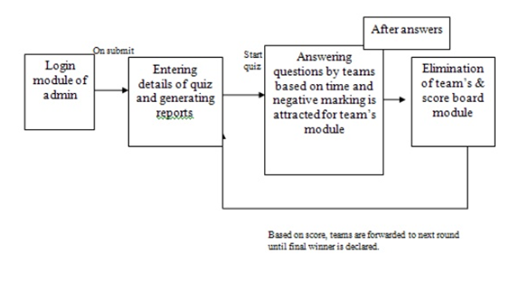
Analysis and Design
Architecture design:

Slide 12
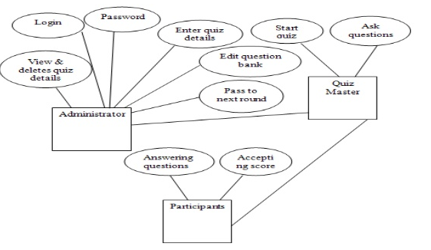
E-R Diagram
ER Diagram stands for Entity Relationship Diagram, also known as ERD is a diagram that displays the relationship of entity sets stored in a database
Figure :E-R diagram

Slide 13

Project Review
This chapters does not discuss with any technical knowledge but only represents the implemented proposed system with some pictures and demonstrate them
This is our first page of our project…When a user click on on the navigation bar after log in. He/she will see some photos of our Homepage..

Slide 14
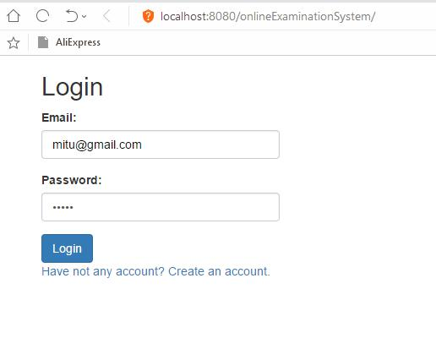
When a user click on our site. The following page will be shown: User must have logged by an email and password. Then click login button.

Slide 15
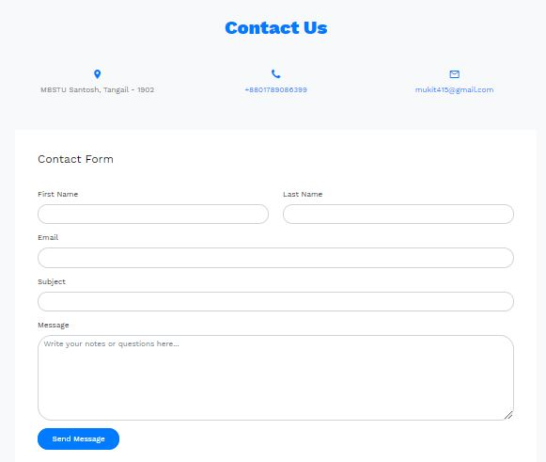
If any user will want to contact with us, he/she can click on Contact Us on the navigation bar. He/she can send any comment or message to us :

Slide 16
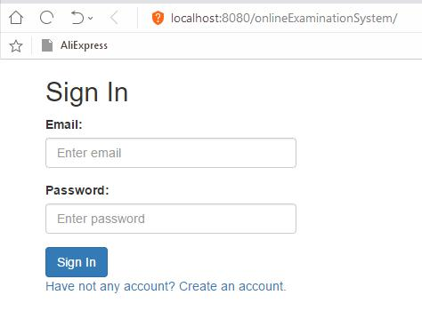
After clicking on register button a mail will send to his email id and it will redirect to sign in page.

Slide 17
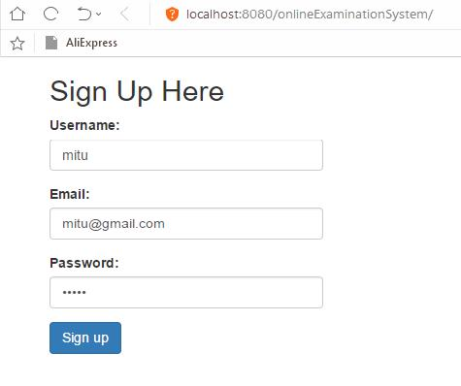
At the heart of a web application is the ability for any user, anywhere in the world, to register an account with your app and start using it.
At first a student should sign up to this application. After completing the registration form, he must click on the register button.

Slide 18
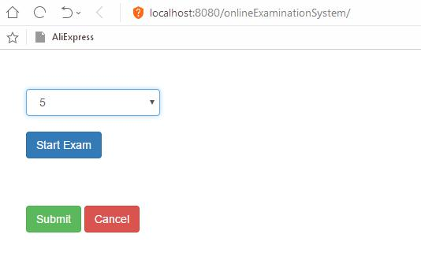
Clicking start exam. A user select question mark from many option and click on start exam button

Slide 19
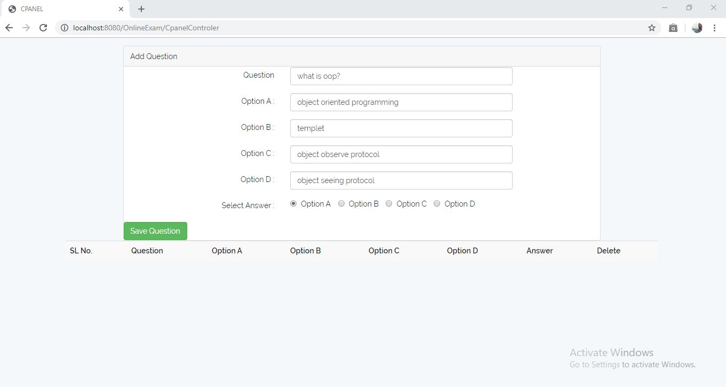
Student can insert questions and option a,b,c,d and the correct answer which is stored in the database

Slide 20
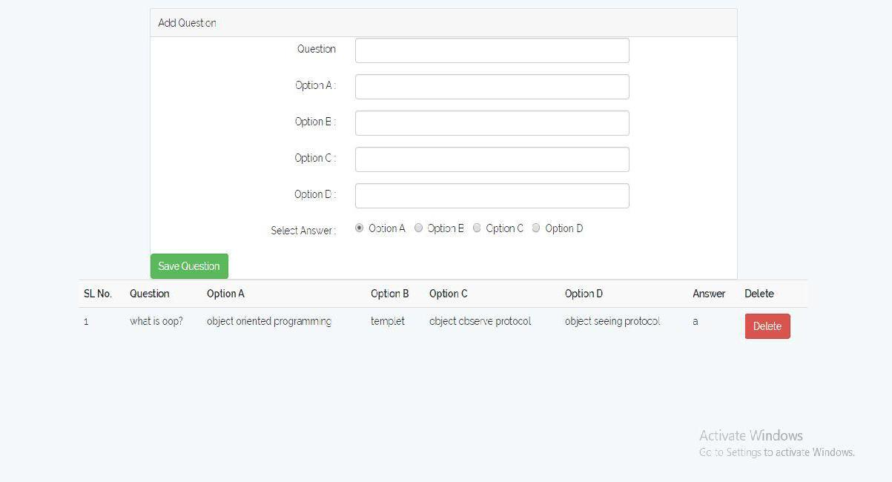
After clicking on the save Question button, then it will save in the database. The question and option can see the question paper and other things preserved in the control panel

Slide 21
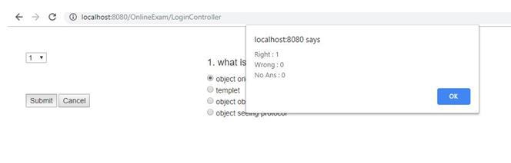
Then he gets the question paper and option of the question. where he chose his desirable option and submit it by completing all the answers and he will notify for that no. of correct and incorrect answer…

Slide 22
Achievement of the project
The proposed projects was an idea of advanced thinking and for the majority of the students who use internet. Online quiz system is not available in all of the universities in our country
The proposed online system focus on reducing the time of finding a student’s all academic results by storing all academic results in a single database. The searching feature helps a student to find his/her current quiz as well as other exam results.
.

Slide 23
Limitation
Like every initial application, this application also has some limitations too. Such as-
The system does not provide any payment method. This system only focus on giving the quiz test of a student in a secure way.
The system cannot give the notification messages to the user’s cell number or mail.
The course teachers can only show the result of their respective courses, they cannot see the full result

Slide 24
Future Work
There are no limits of efficiency and developing. Every system can be more and more developed day by day. A modern system today is a backdated system tomorrow. So to keep updated with time, our proposed projects have some future plans.
A SMS notification system when a result published.
We will provide more user friendly interface in future.
To enhance security using QR-code verification.
Email to each student individually

Slide 25
Conclusion
We are confident that this online quiz system website will be helpful to a students in real life. Also developing their skill. And we hope we will make it better to use in future.

Slide 26
Thank You

